Slide 1
OWASP <City> Chapter Meeting
<Date here>
<location here>
Notes:
Change this to your local chapter name. Add any host or food/beverage sponsor logos you need. Look at OWASP London for a chapter that has localized its front slide. Your custom slide must have the OWASP logo on it, but that’s the only restriction to changing the front slide.

Slide 2
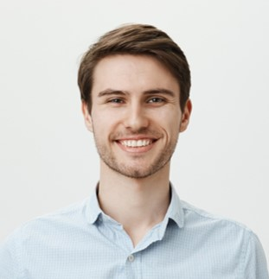
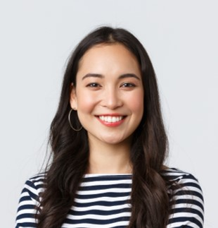
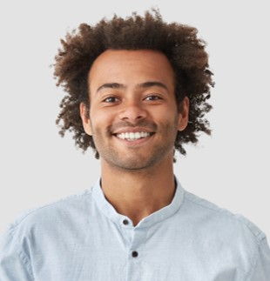
Meet Our Chapter Leaders
Chapter Leader 1
Chapter Leader 2
Chapter Leader 3
Follow our Chapter on Social Media: <links here> Join our OWASP Slack channel: #chapter-<city>

Slide 3
Agenda
OWASP Introduction & welcome - Chapter Leaders
Speaker1: Talk 1
Break - pizza/drinks/networking
Speaker2: Talk 2
Drinks & Networking: <location>

Slide 4
Code of Conduct
Please Be Nice and Respectful to each other!
OWASP is a comfortable and welcoming community for everyone. By participating you agree to the OWASP Code of Conduct. The Code of Conduct can be found online here:
https://policy.owasp.org/operational/code-of-conduct

Slide 5
THE OWASP FOUNDATION
MISSION: To be the global open community that powers secure software through education, tools, and collaboration.
As a worldwide non-profit charitable organization concerned with software security, OWASP:
Supports the building of impactful projects;
Develops & nurtures communities through events and chapter meetings worldwide; and
Provides free and open-source educational publications, resources & tools

Slide 6
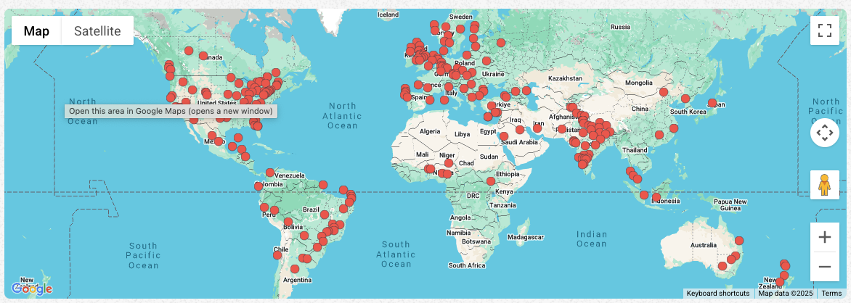
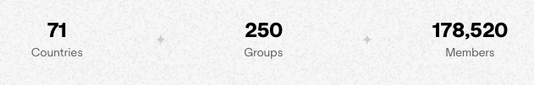
OWASP WORLDWIDE

Slide 7
WE ARE ALL VOLUNTEERS!
BECOME A MEMBER TODAY TO HELP SUSTAIN OWASP’S MISSION

Slide 8
Become an OWASP member today!
Ongoing support of OWASP’s mission
Networking and Volunteer opportunities
Discounts on Cybersecurity Conferences (RSA, BlackHat)
Discounts on OWASP Global AppSec events and training
Access to Training Platforms kindly provided by Corporate Supporters
GSuite account - your own yourname@owasp.org email
Vote in the OWASP Board elections!
Stand for the Board
=> https://owasp.org/join

Slide 9
Member Benefits From Our Supporters
Hands-on application security training through the SecureFlag Platform​ (with Labs)
Access to Codebashing Secure Coding Training Platform​
Access the Ubiq Platform​, an easy-to-use, developer-first encryption-as-code platform
Access Equixly​, the virtual hacker to secure your API
more benefits coming soon…

Slide 10
Company? Become a corporate supporter today!
Support OWASP’s mission!
Global AppSec Conference priority placement on expo floor
Logo and blurb on OWASP website >2mln impressions/month
Reach 250,000+ participants globally (depends on package)
Donations to OWASP are Tax deductible in the USA - we are 501c(3)
Packages and benefits for all budgets/company sizes:
=> https://owasp.org/supporters

Slide 11




OWASP Projects
OWASP has 400+ open-source projects:
Flagship Projects
Production Projects
Lab Projects
Incubator Projects

Slide 12
Flagship Projects
OWASP Amass
OWASP Application Security Verification Standard (ASVS)
OWASP Cheat Sheet Series
OWASP CycloneDX (ECMA-424)
OWASP Defectdojo
OWASP Dependency-Check
OWASP Dependency-Track
OWASP Juice Shop
OWASP Mobile Application Security
OWASP CRS
OWASP OWTF
OWASP SAMM
OWASP Security Shepherd
OWASP Top Ten
OWASP Web Security Testing Guide

Slide 13
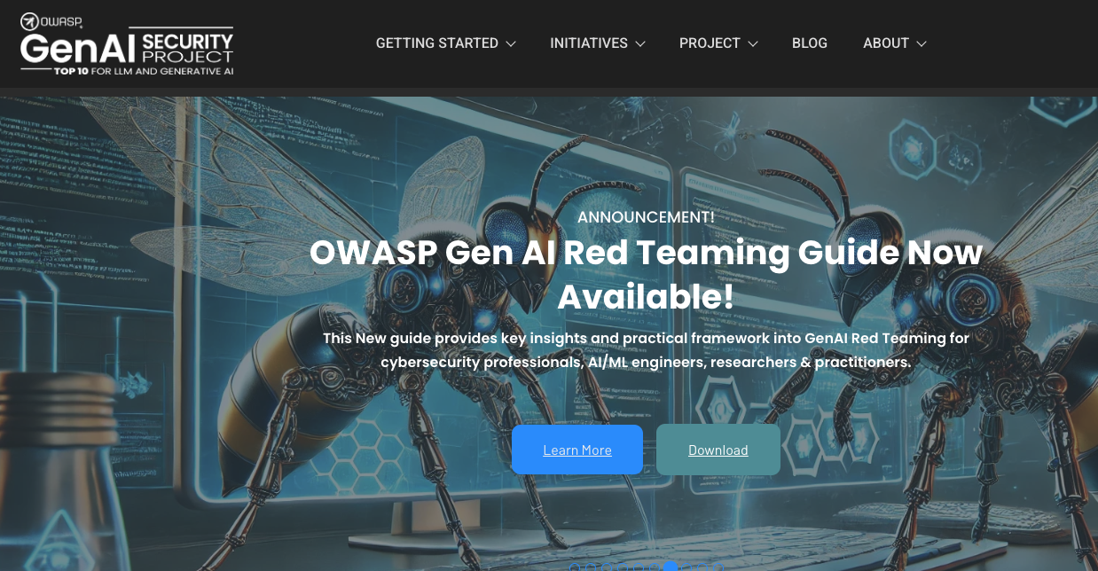
Project Spotlight: GenAI Security Project

Slide 14
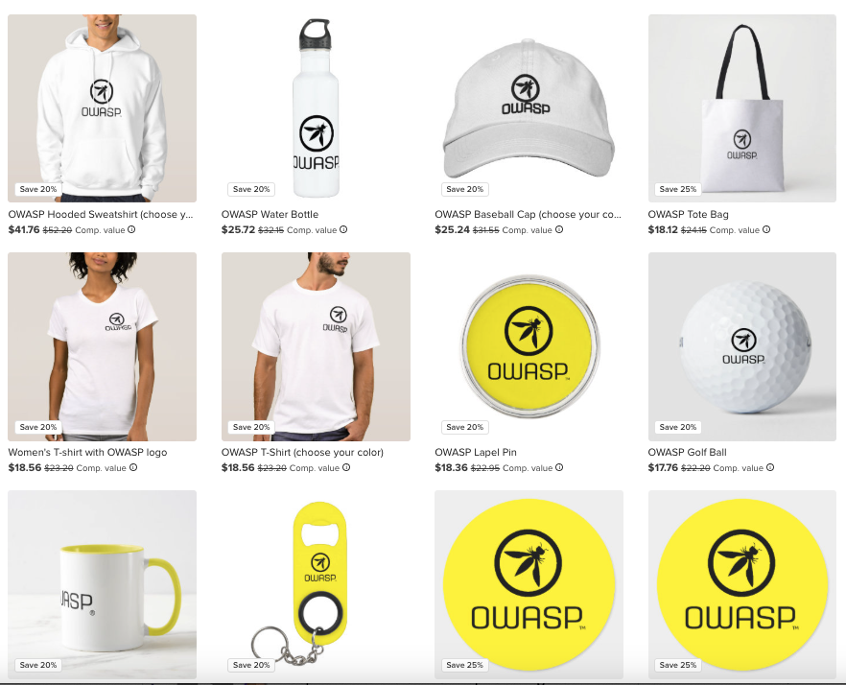
OWASP Merch Store: owasp.org/store

Slide 15
Upcoming Global & Regional OWASP Events

Slide 16
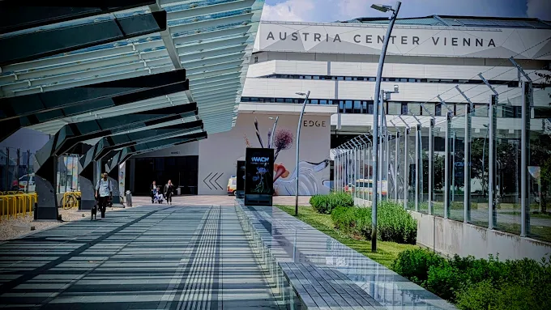
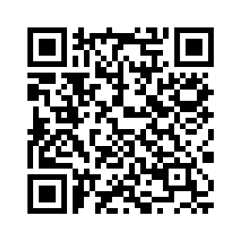
OWASP Global AppSec EU 2026 Vienna June 22-26, 2026
CALL FOR PAPERS NOW OPEN!!!

Slide 17


Slide 18
Upcoming Regional Events (EMEA)
December 2-3, 2025: OWASP Benelux Days Conference
February 25-27, 2026: OWASP London Training Days
May 18, 2026: OWASP AppSec Israel 2026 Conference
June 17-18, 2026: OWASP Italy AppSec Days

Slide 19
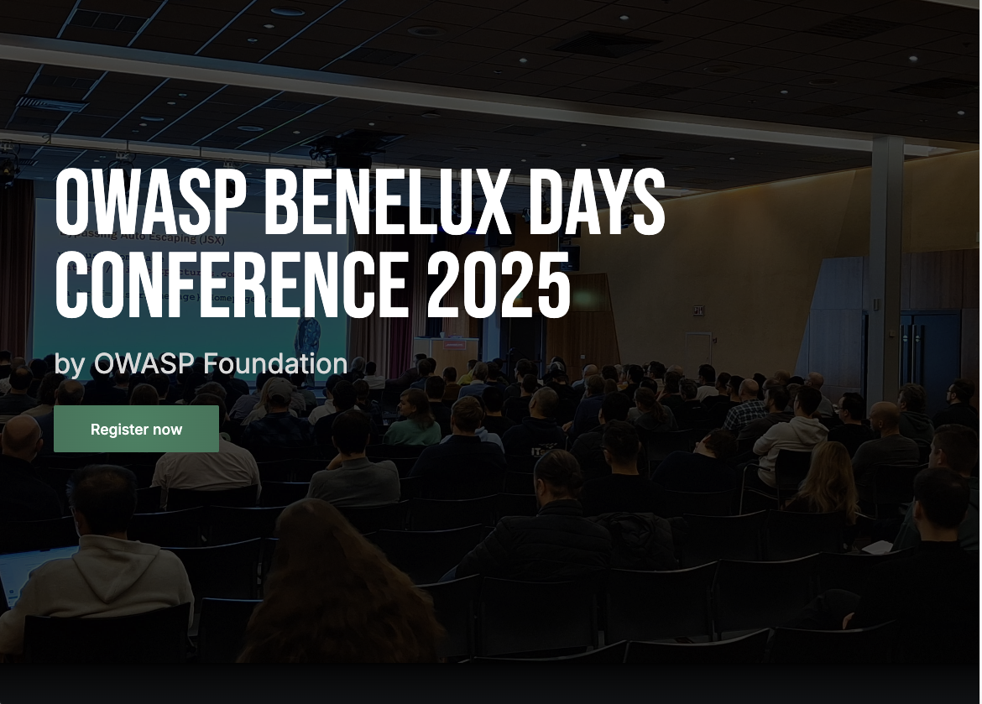
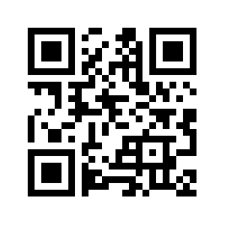
Conference Day
2/Dec/2025
Location
Mechelen, Belgium
Training Day
3/Dec/2025

Slide 20
Upcoming Regional Events (Americas)
April 11, 2026 OWASP BASC 2026 Conference, Boston, MA
TBC: OWASP SNOWFORC (Denver, CO)
October 27-30, 2026: OWASP LASCON (Austin, TX)

Slide 21
Board Elections
Become an OWASP member by September 30th if you wish to vote!
Board Nominations close August 30th
Election runs October 15 – October 30th
Board Directors announced November 4th
IF YOU ARE A MEMBER - PLEASE REMEMBER TO VOTE!

Slide 22









Thank you to our local chapter sponsors
Notes:
These are OWASP’s Platinum sponsors. Please remove them and place your local sponsors logos here. Remember to thank them for hosting you, providing food and beverages, etc. If you are seeking local sponsors, say so! If you need a high quality logo of one of corporate sponsors, we probably have it on the main OWASP Github: https://github.com/OWASP/owasp.github.io/tree/main/assets/images/corp-member-logo

Slide 23
Speakers
Please welcome our speakers
Notes:
Change this to be the month of your meeting, or your chapter’s name. It’s up to you.

Slide 24
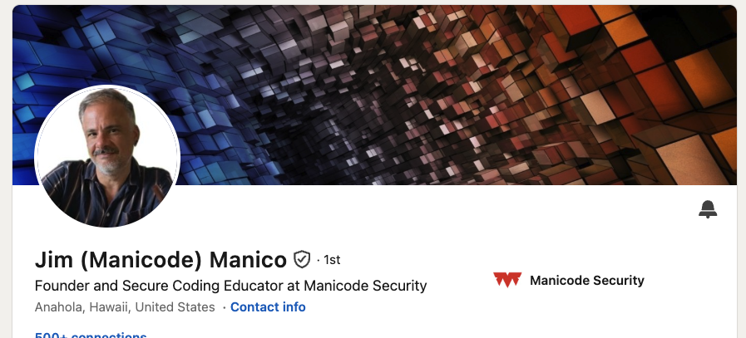
Speaker 1 Bio
Notes:
Change this to be your speaker(s). If you need speakers, please look at the Speakers Bureau maintained by the Chapter Committee, or contact the Chapter Committee for help! Chapter-committee@owasp.org
https://github.com/OWASP/www-committee-chapter/blob/master/resources/speakers/speakers-bureau.csv

Slide 25

THANK YOU
FOLLOW US ON SOCIAL MEDIA
X/Mastodon/LinkedIn: @OWASP
Facebook: @OWASPFoundation
YouTube: @OWASPGlobal
DRINKS & NETWORKING AT: <pub name>
NEXT CHAPTER MEETUP
<date here>

